Slide 1

Think PowerShell is meh? Meet dbatools
Rob Sewell @SqlDbaWithBeard
https://beard.media/presentations

Slide 2

Rob Sewell
Bearded Consultant, Automator, Trainer
Consultant Sewells Consulting Ltd
beard.media/book
Dbachecks
PowerShell & Data Community
/robsewellsqldba
@sqldbawithbeard
SQLDBAWithABeard.com

Slide 3


Slide 4
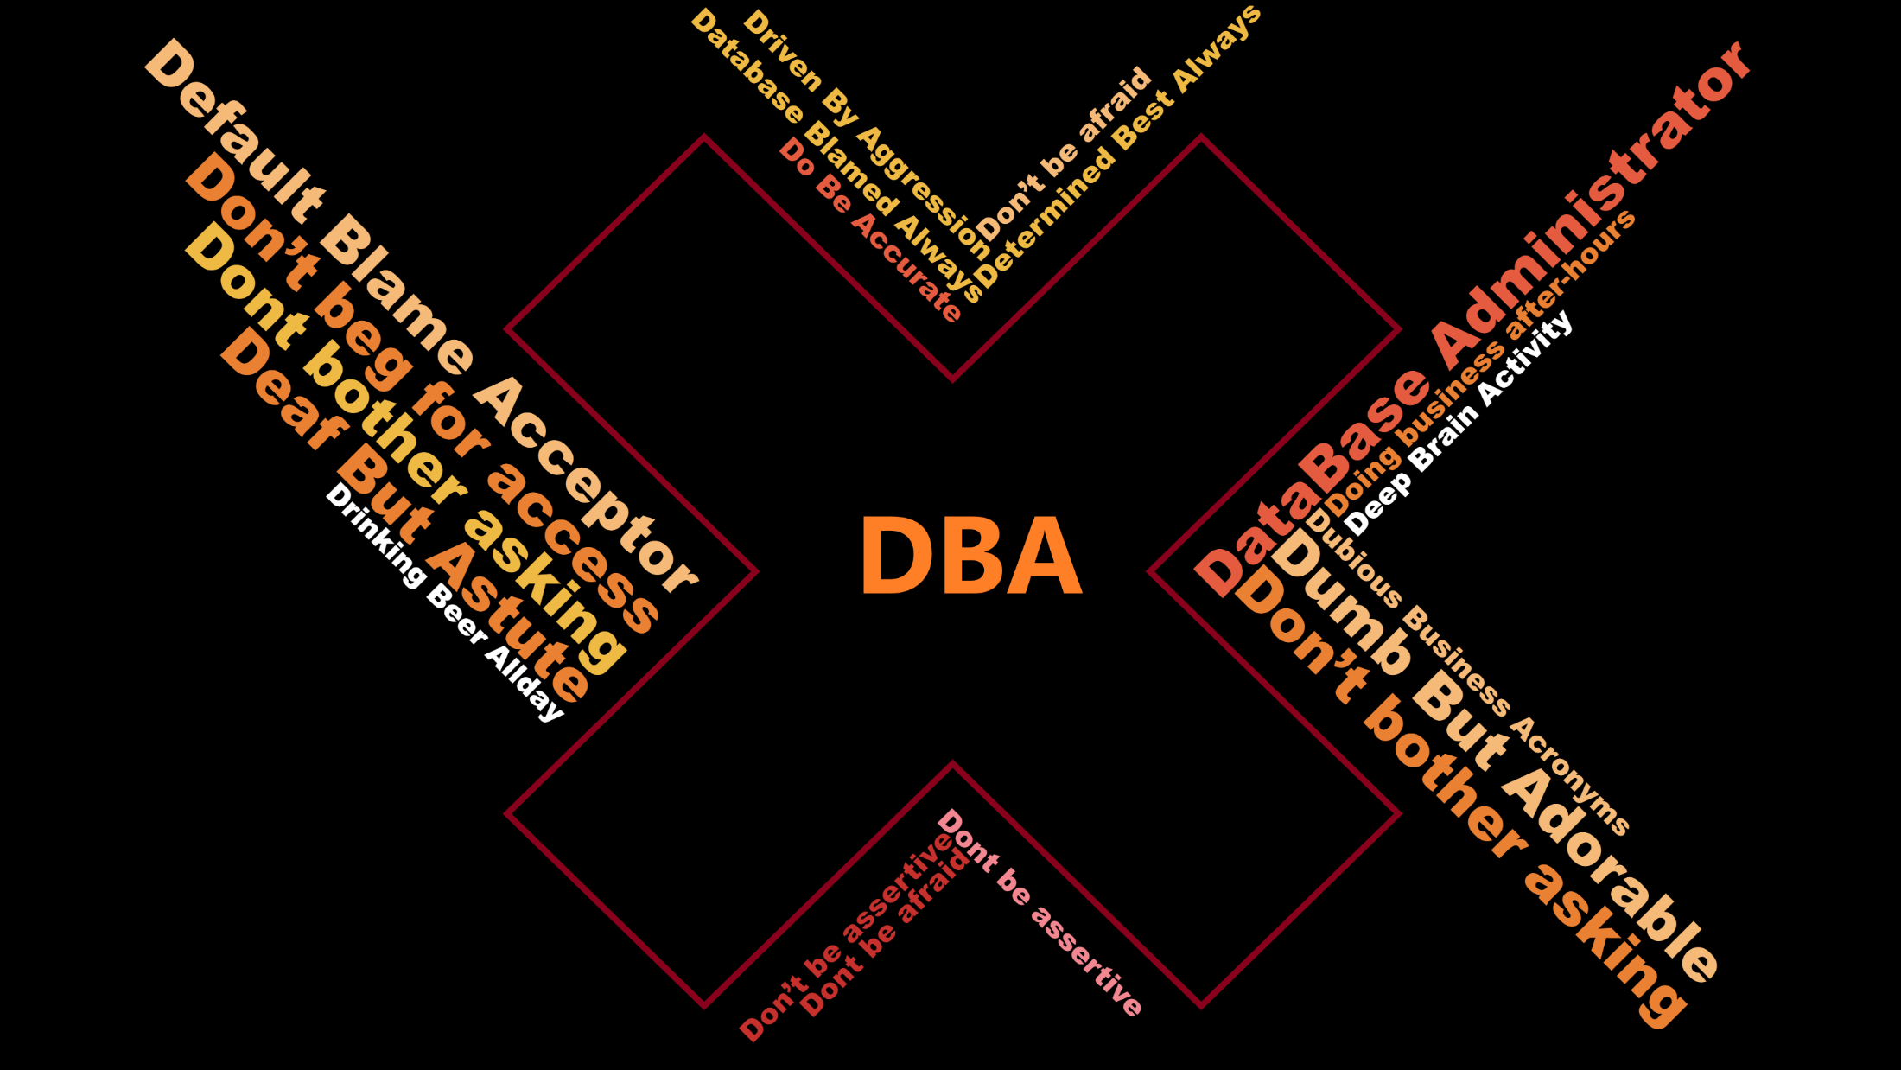

Slide 5
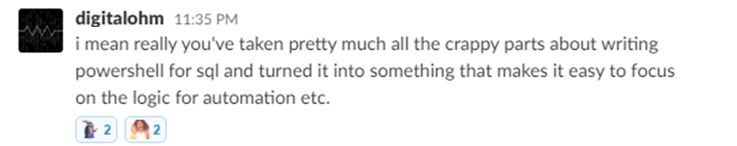
What is dbatools?

Slide 6

What is dbatools - Basically

Slide 7
What is dbatools? - Actually
Photo by Kasya Shahovskaya on Unsplash

Slide 8

What is dbatools? – well basically
Notes:
We make it easy

Slide 9

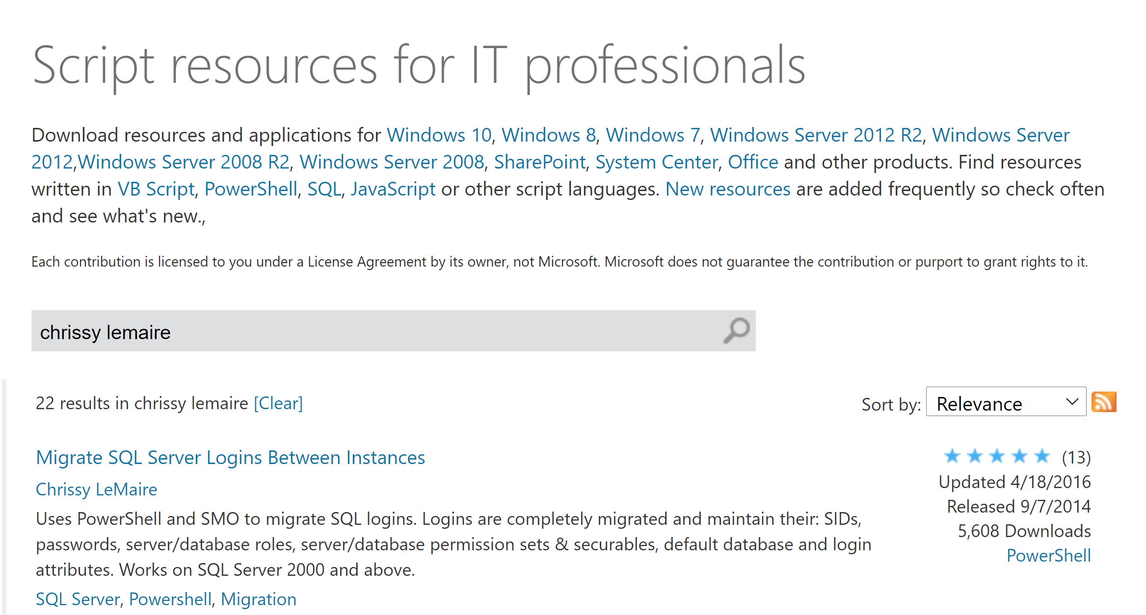
07/2014
Published to GitHub & ScriptCenter
07/2014
Need to Migrate Sharepoint databases
Microsoft Script Center

Slide 10
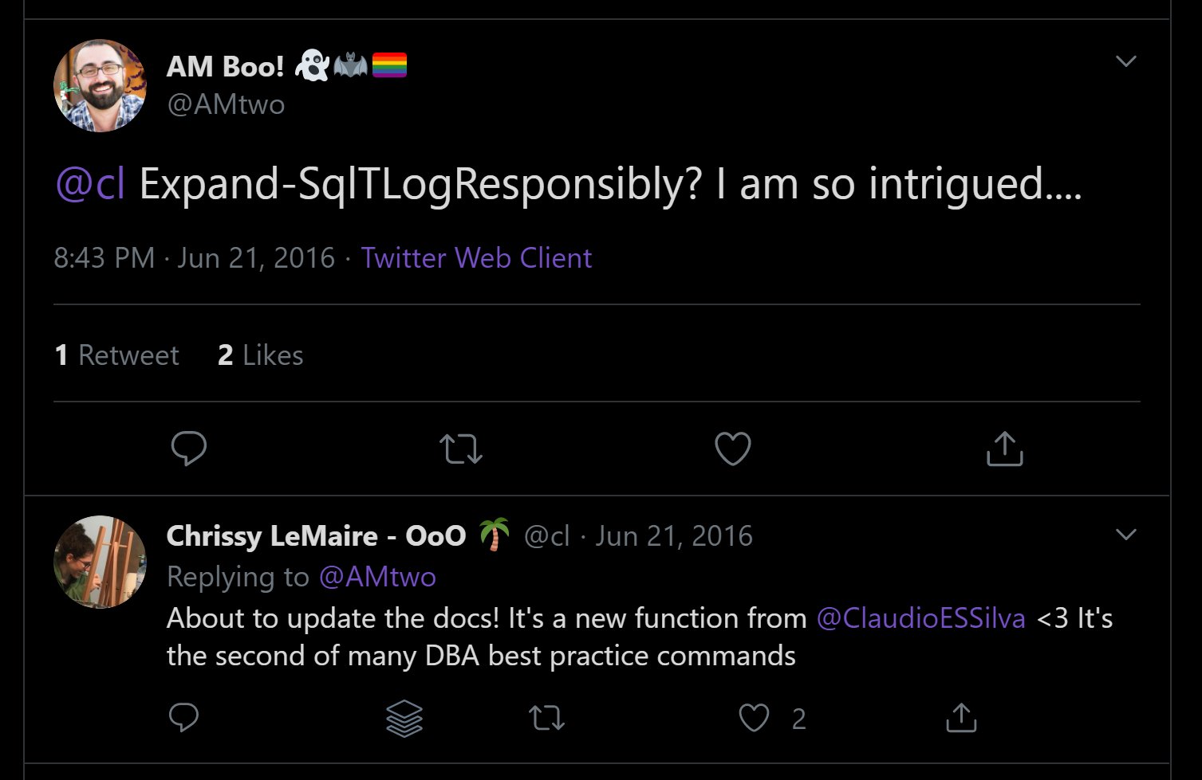
07/2014
Published to GitHub & ScriptCenter
07/2014
06/2016
Need to Migrate Sharepoint databases
First Community Contributions

Slide 11
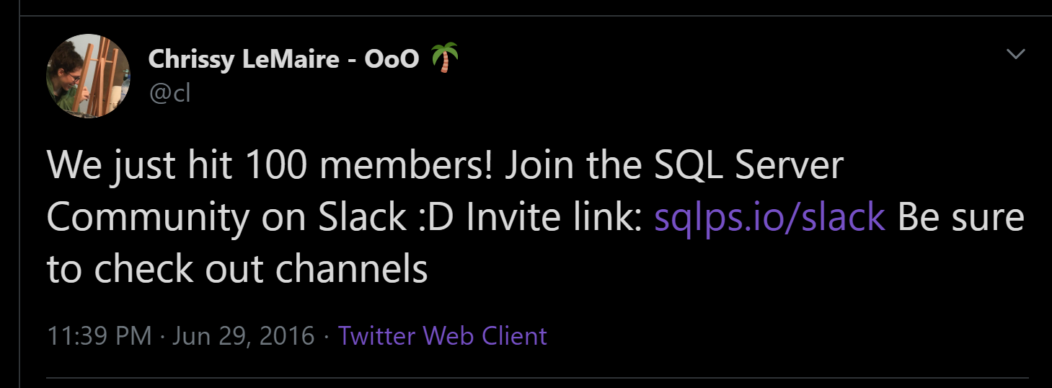
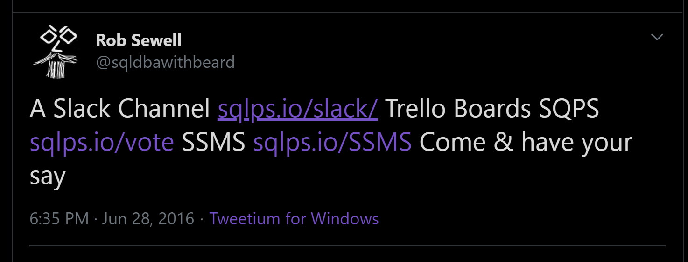
07/2014
06/2016
Published to GitHub & ScriptCenter
SQL Community Slack Was Born
07/2014
06/2016
Need to Migrate Sharepoint databases
First Community Contributions

Slide 12
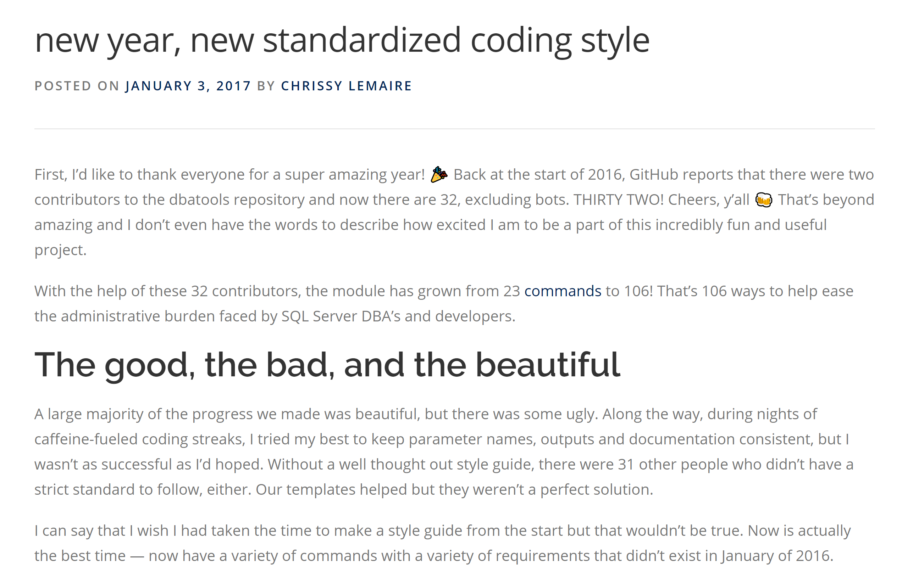
07/2014
06/2016
32 Contributors
Published to GitHub & ScriptCenter
SQL Community Slack Was Born
07/2014
06/2016
01/2017
Need to Migrate Sharepoint databases
First Community Contributions
The Road to 1.0 starts

Slide 14
07/2014
06/2016
32 Contributors
Published to GitHub & ScriptCenter
SQL Community Slack Was Born
07/2014
06/2016
01/2017
Need to Migrate Sharepoint databases
First Community Contributions
The Road to 1.0 starts

Slide 15
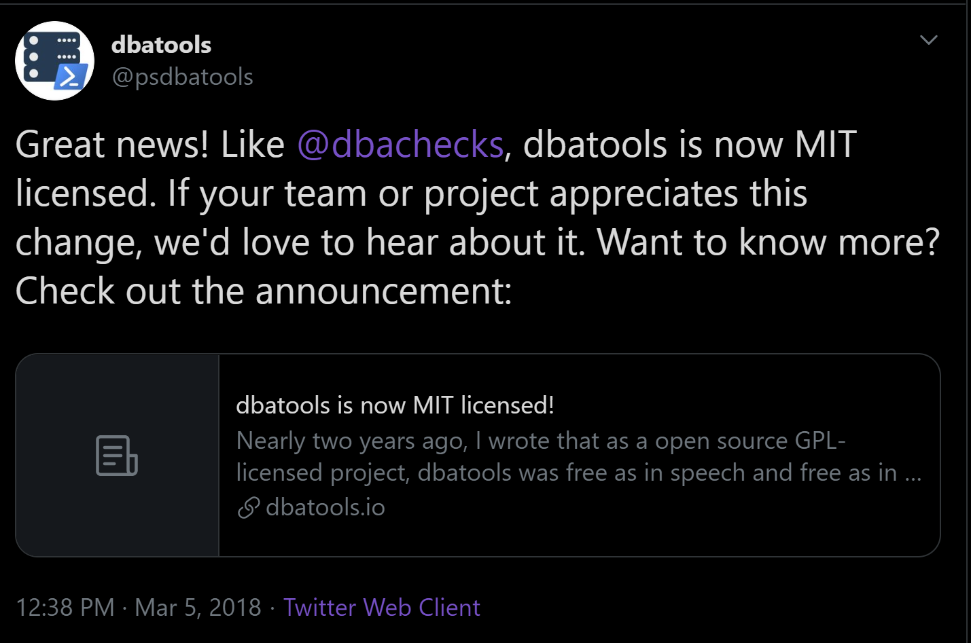
07/2014
06/2016
32 Contributors
Published to GitHub & ScriptCenter
03/2018
SQL Community Slack Was Born
MIT Licence
07/2014
06/2016
01/2017
Need to Migrate Sharepoint databases
First Community Contirbutions
The Road to 1.0 starts

Slide 16
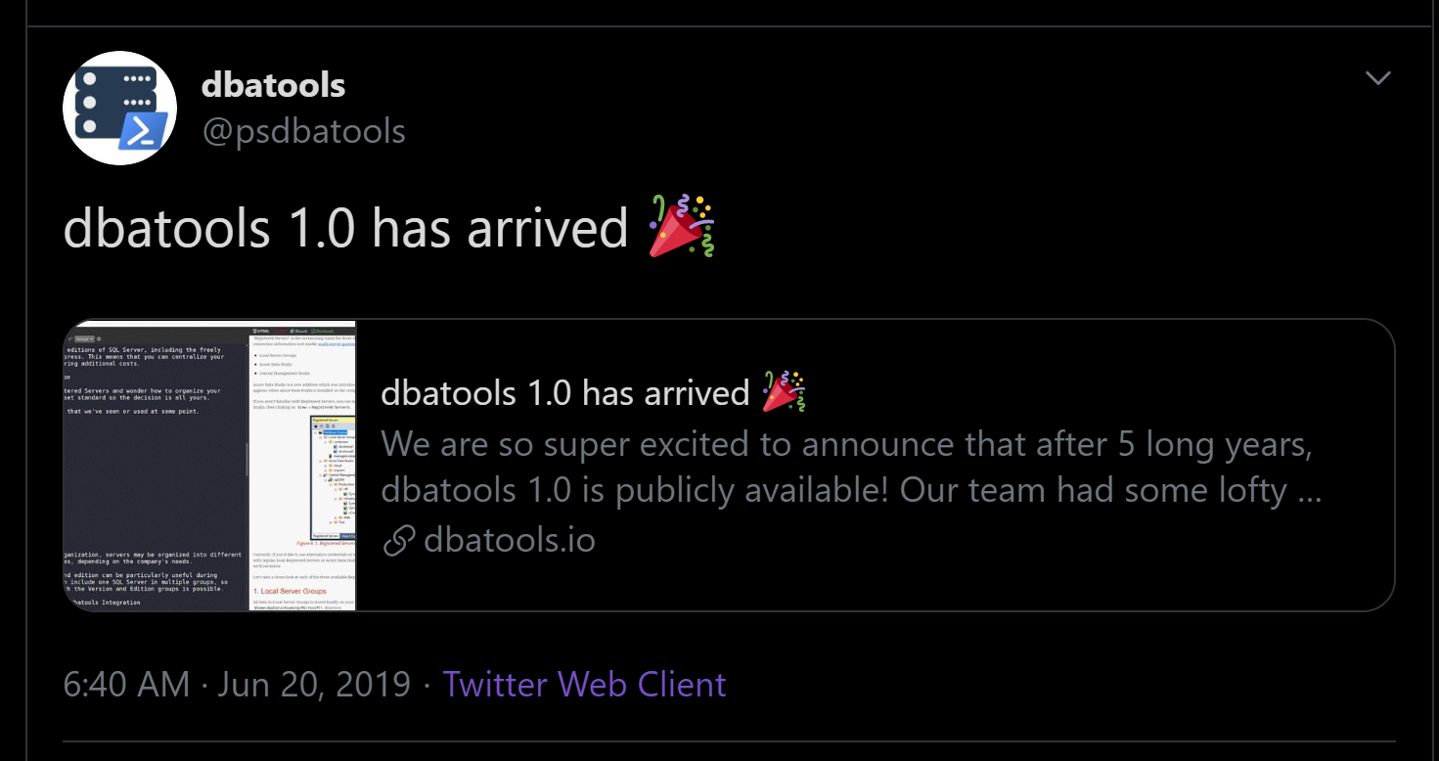
07/2014
06/2016
32 Contributors
Published to GitHub & ScriptCenter
03/2018
SQL Community Slack Was Born
MIT Licence
06/2016
01/2017
06/2019
07/2014
First Community Contirbutions
The Road to 1.0 starts
Dbatools 1.0
Need to Migrate Sharepoint databases

Slide 17
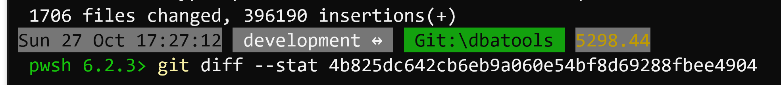
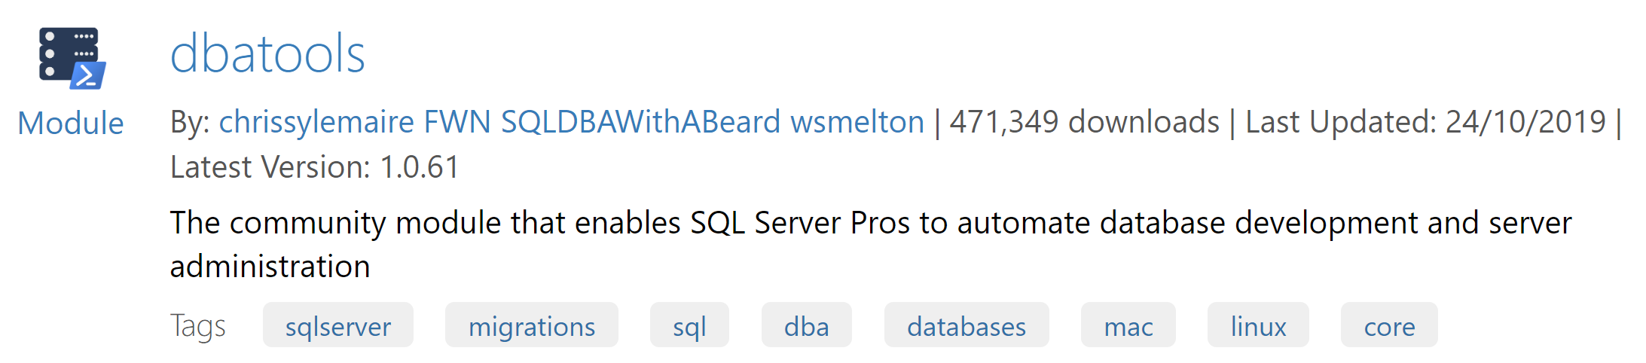
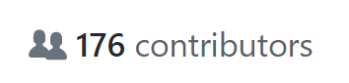

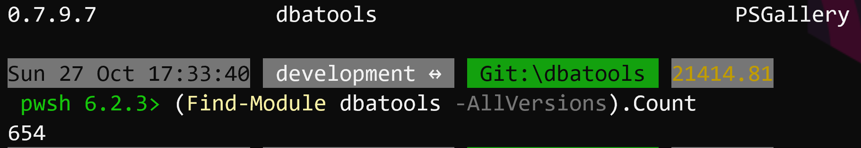
07/2014
06/2016
32 Contributors
Published to GitHub & ScriptCenter
03/2018
11/2019
SQL Community Slack Was Born
MIT Licence
06/2016
01/2017
06/2019
07/2014
First Community Contirbutions
The Road to 1.0 starts
Dbatools 1.0
Need to Migrate Sharepoint databases

Slide 18


























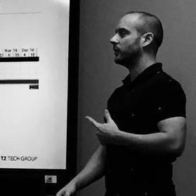











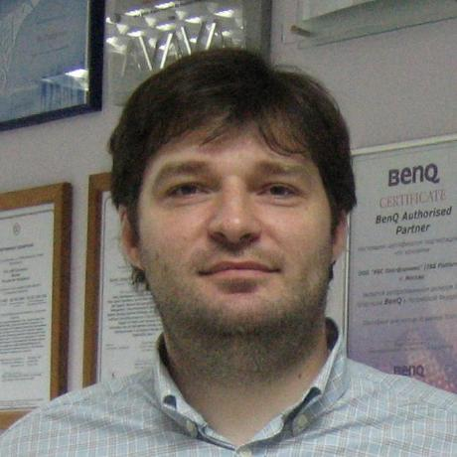






07/2014
06/2016
32 Contributors
Published to GitHub & ScriptCenter
SQL Community Slack Was Born
03/2018
11/2019
MIT Licence
07/2014
06/2016
01/2017
06/2019
Need to Migrate Sharepoint databases
First Community Contributions
The Road to 1.0 starts
Dbatools 1.0

Slide 19
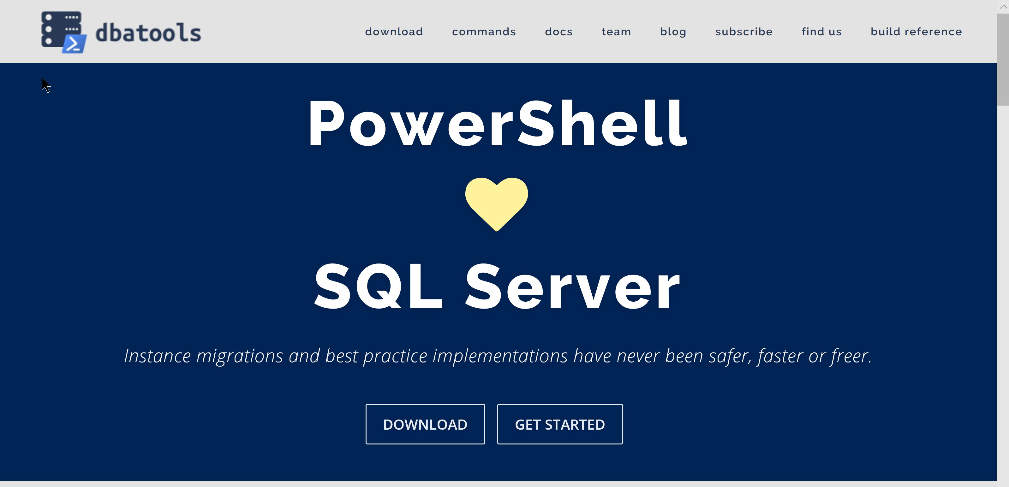
dbatools.io

Slide 20

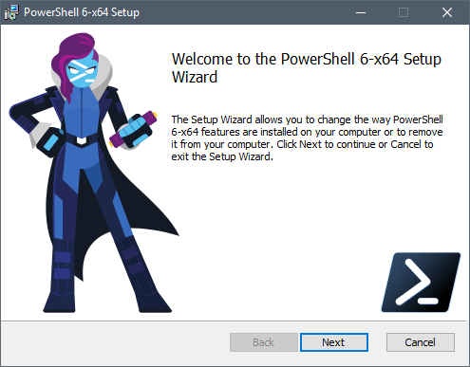
Client
PowerShell v5.1
Client
PowerShell v3
Better
Some functionality is not available
Also consider PowerShell 7 pwsh
Cross Platform

Slide 21

Support
SQL Server 2000 – 2019 *
Express – Enterprise Edition
Clustered and stand-alone instances
Windows and SQL authentication
Default and named instances
Multiple instances on one server
What about Azure?
Notes:
* Azure

Slide 22
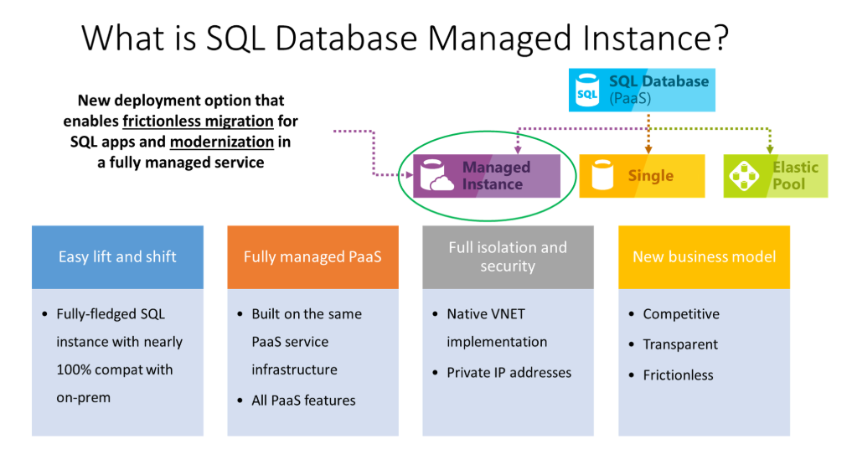
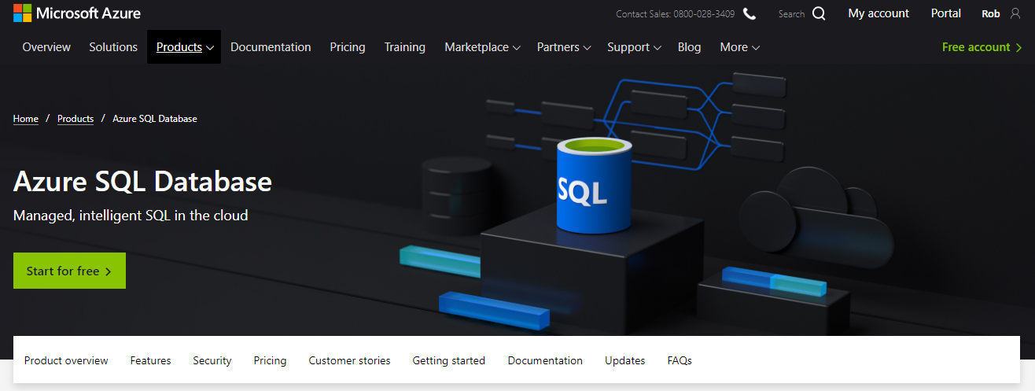
What about Azure?
Notes:
* Azure

Slide 23
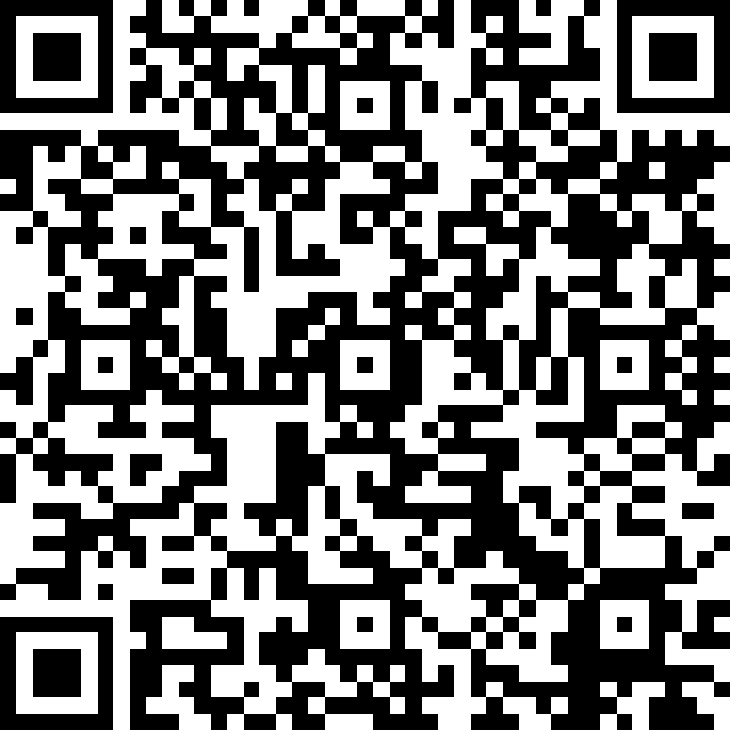
Thank you very much for your attention. Vielen Dank für Eure Aufmerksamkeit.

